Slide 1

Introduction to Microbiome Analysis
UC-CCHMC Microbiome Course
June 19, 2019
David Haslam, M.D.
Associate Professor
Division of Infectious Diseases
Notes:
1

Slide 2
Definitions
Microbe: an individual organism (usually implies a species)
Taxa: refers to individual type of organism, could be species, genus, etc
Microbiota: A community of microbes in a defined environment
Metagenome: The collection of genes and genomes that comprise a microbiota
Metagenomics: The study of genes and genomes that comprise a microbiota
Microbiome: Includes microbiota (the organisms), their genes, and their interaction with the environment

Slide 3
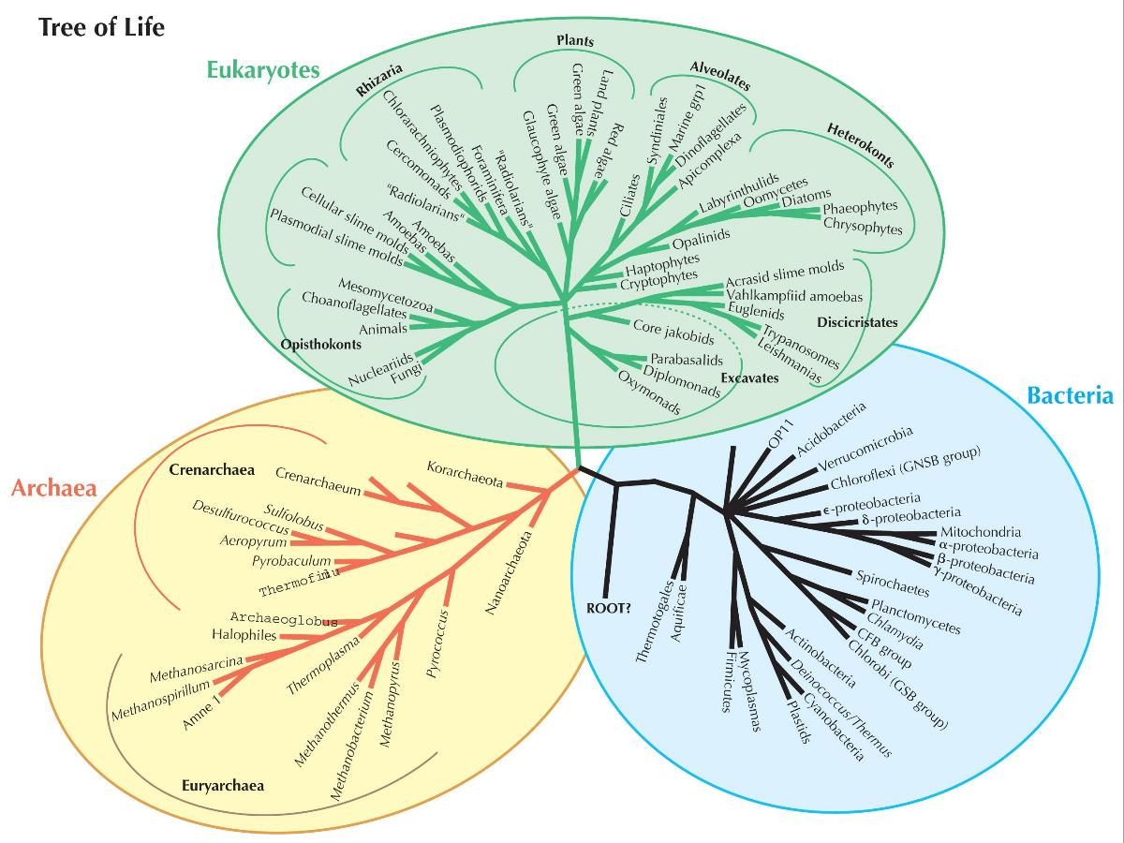
Most life on Earth is Microbial

Slide 4
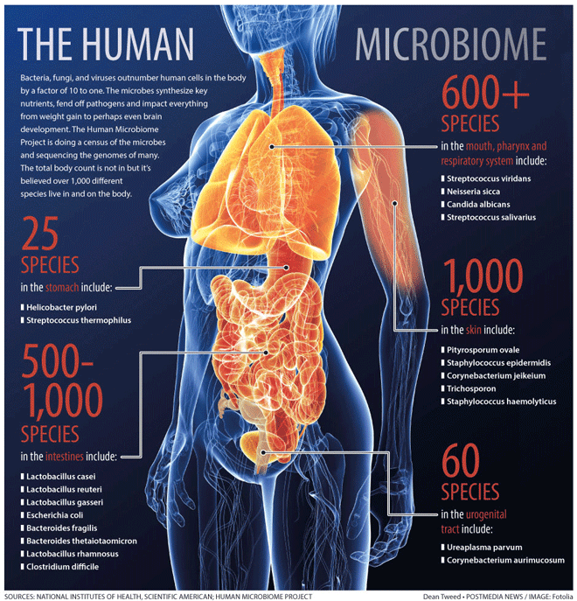
The human microbiome is comprised of thousands of species
which tend to inhabit distinct environments – oral, fecal, and skin microbiota most diverse

Slide 5
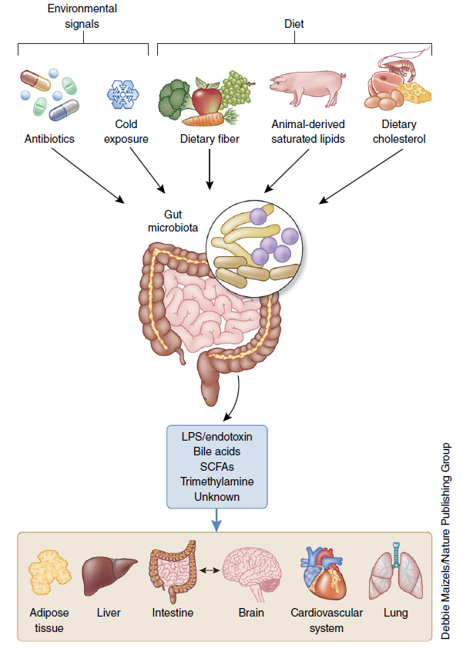
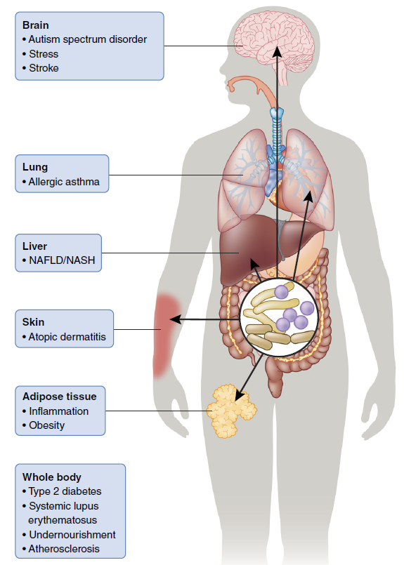
Microbial metabolites may enter bloodstream and impact various organs
Schroeder, B. O. and F. Backhed (2016). "Signals from the gut microbiota to distant organs in physiology and disease." Nat Med 22(10): 1079-1089.

Slide 6
Metabolic functions and diseases impacted by the microbiome
Functions of the microbiota
Host Physiology
Adaptive immunity
Innate immunity
Cell proliferation
Bone density
Vascularization
Biosynthesis
Neurotransmitters
Steroid hormones
Vitamins
Metabolism
Dietary components
Bile salts
Drugs
Xenobiotics
Diseases associated with microbiota
Allergies / Allergy protection
Atherosclerosis & Thrombosis
Cancer
Diabetes Mellitus
Immune-mediated Inflammatory Diseases
Inflammatory bowel disease
Multiple sclerosis
Rheumatoid arthritis
Kwashiorkor
Liver Diseases
Metabolic Syndrome and Obesity
Neurodevelopmental & Psychiatric
Autism
Depression
Alzheimer’s disease
Parkinson’s disease

Slide 7
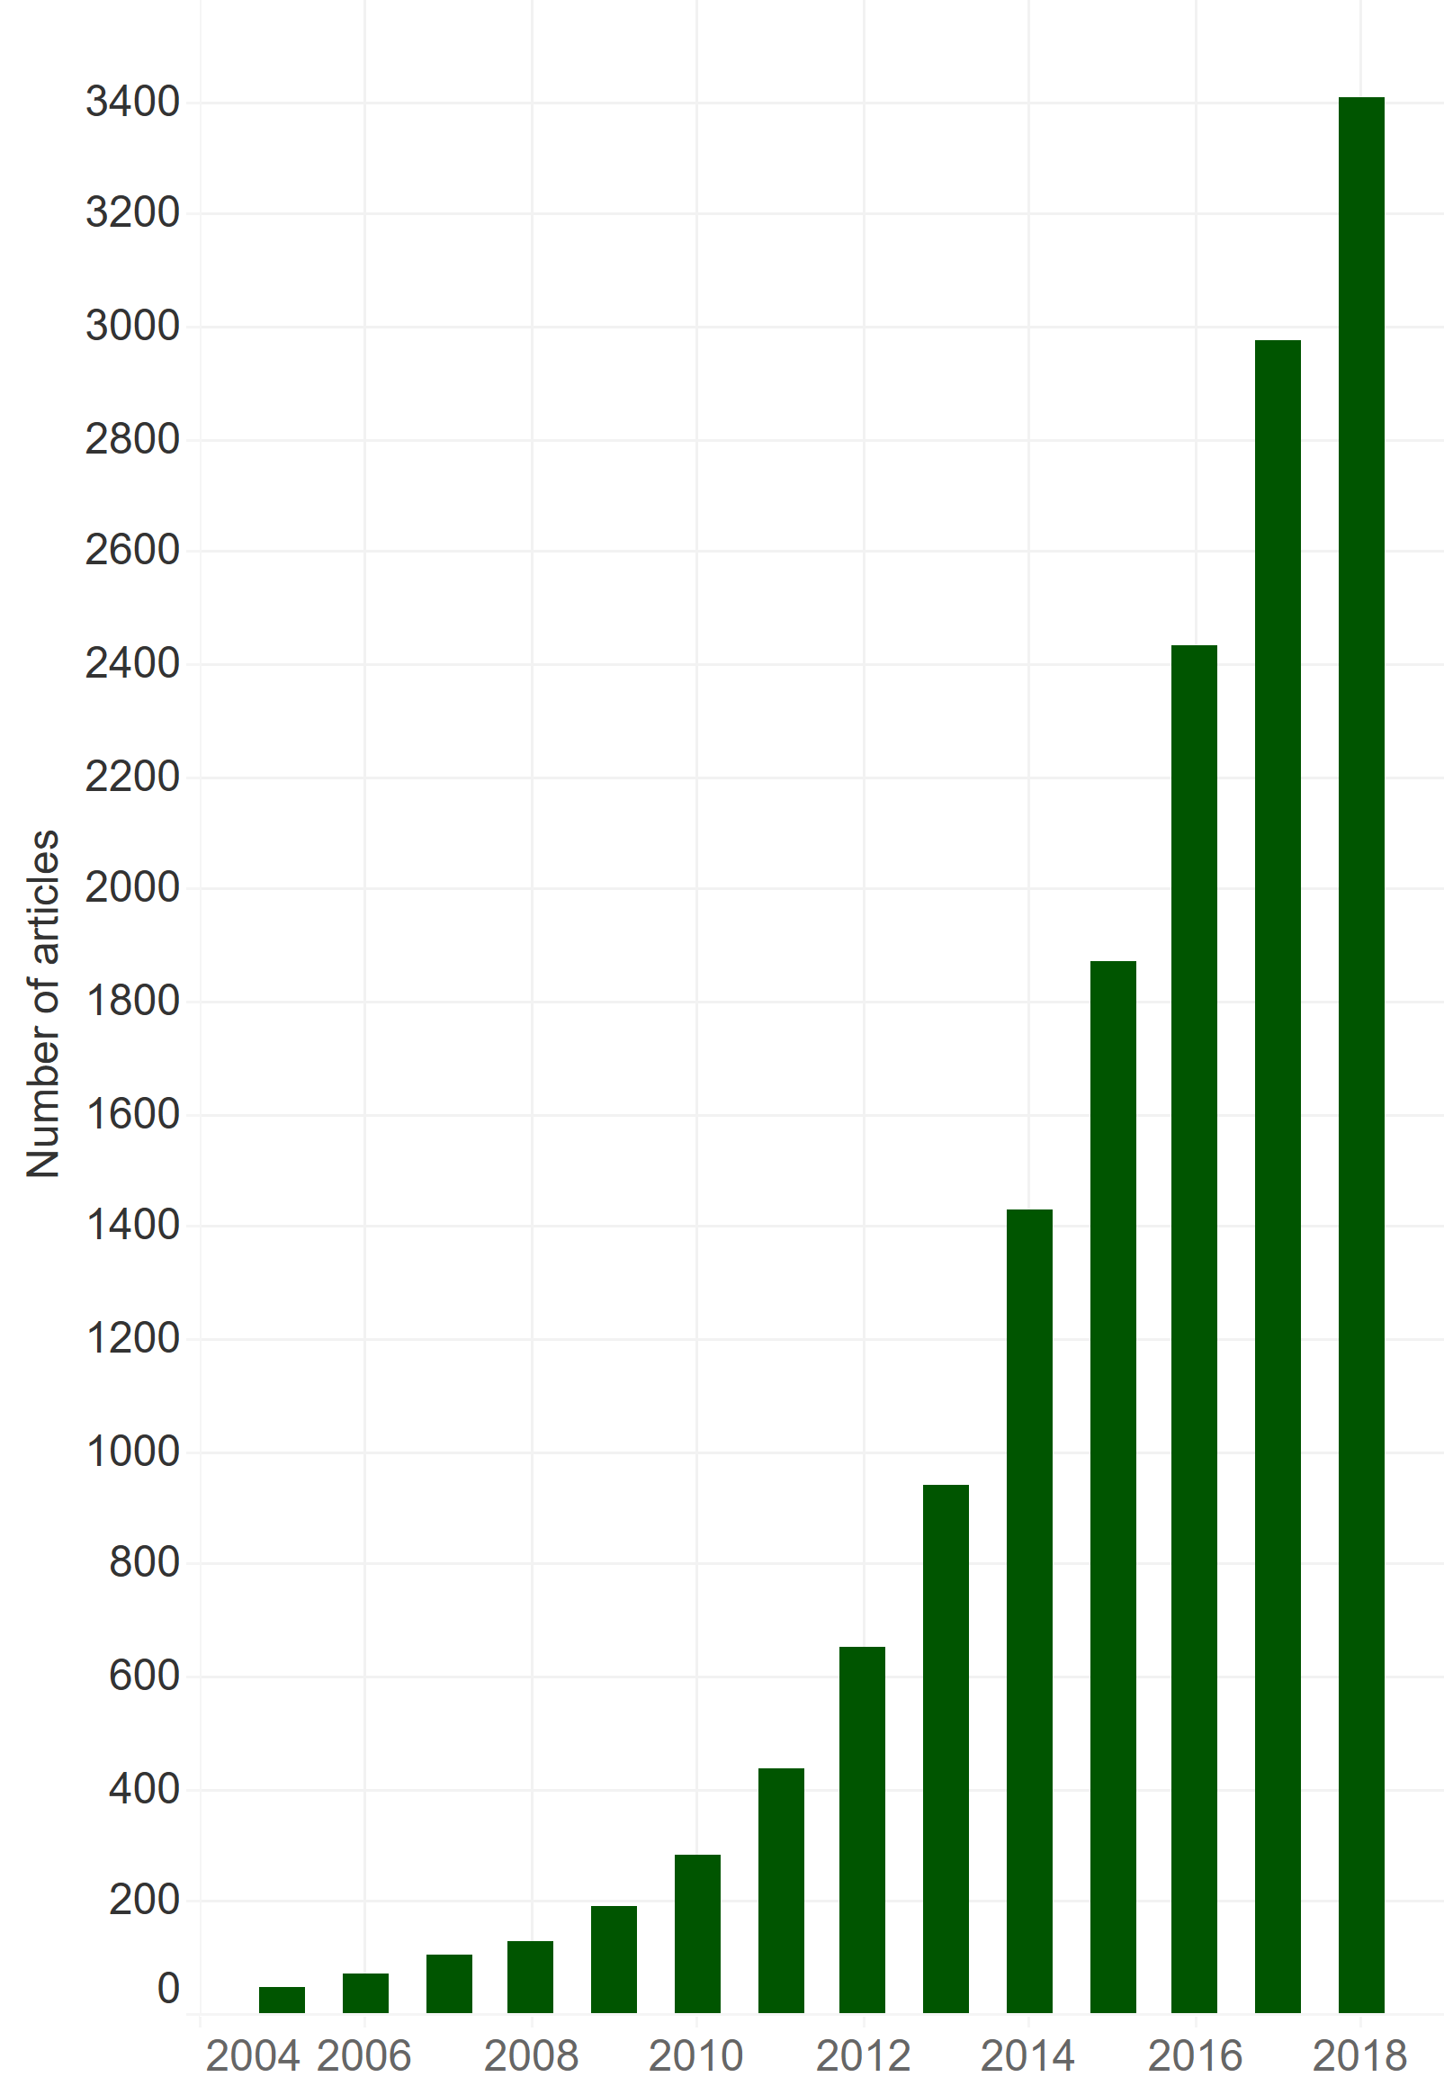
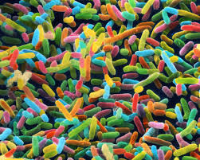
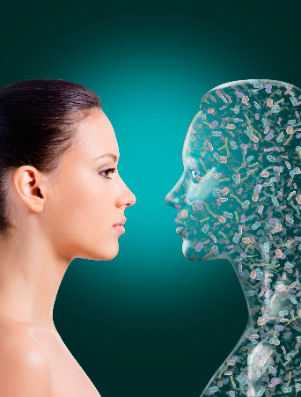
‘Microbiome and disease’ : Number of articles per year

Slide 8
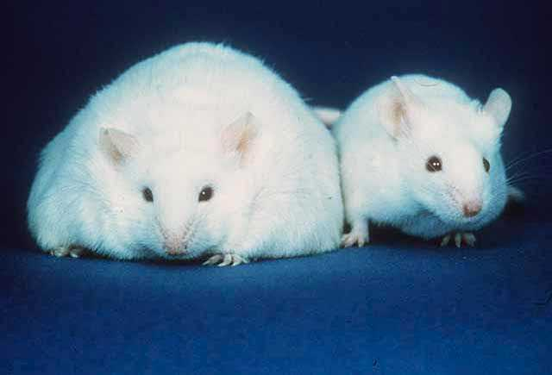
Potential role of the intestinal microbiome in obesity

Slide 9
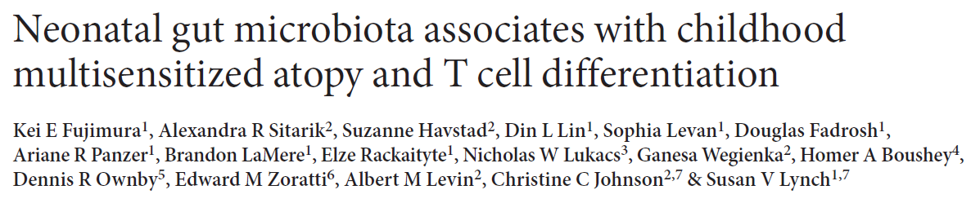

Slide 10
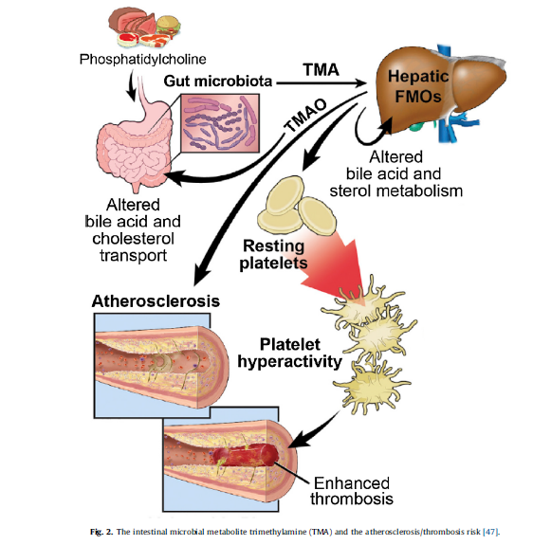
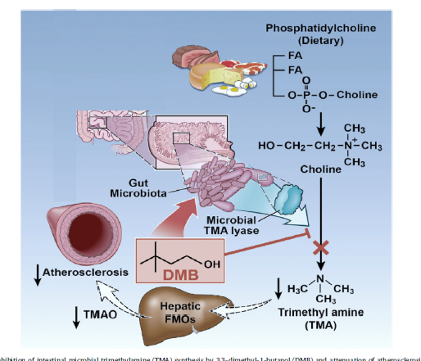
Potential role of the intestinal microbiome in heart disease
Microbiota convert dietary phosphatidylcholine to trimethylamine (TMA) which is converted to TMAO in the liver
Elevated TMAO is correlated with atherosclerosis
Blum HE: The human microbiome. Adv Med Sci 2017, 62:414-420.

Slide 11
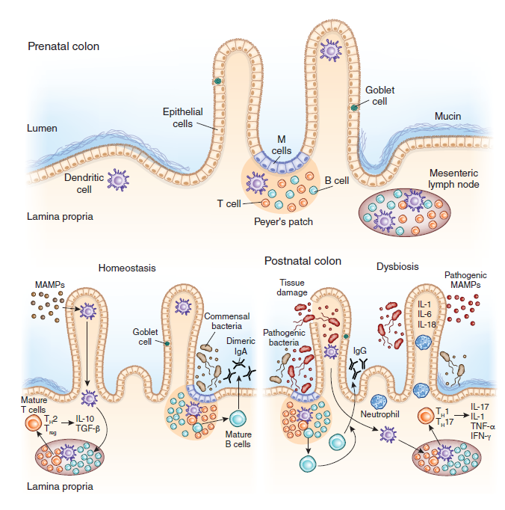
Potential role of the intestinal microbiome in immunity and allergy
“Normal” immune development
“Pathologic” immune development
The microbiota helps shape the immune system
Disruption of the microbiome may contribute to allergic and inflammatory diseases

Slide 12
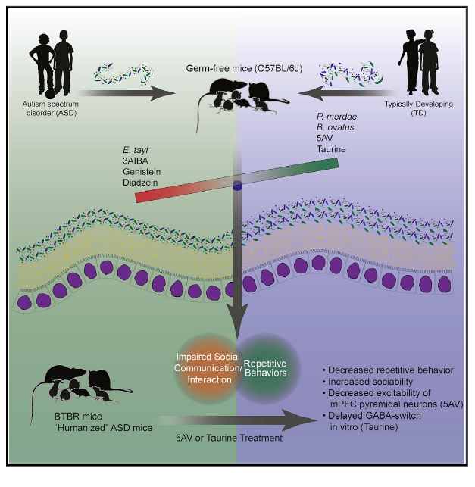
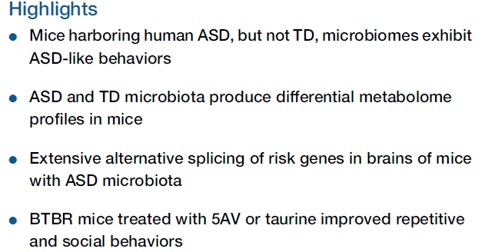

Potential role of the intestinal microbiome in autism
Sharon, G et. al. (2019). "Human Gut Microbiota from Autism Spectrum Disorder Promote Behavioral Symptoms in Mice." Cell 177(6): 1600-1618

Slide 13
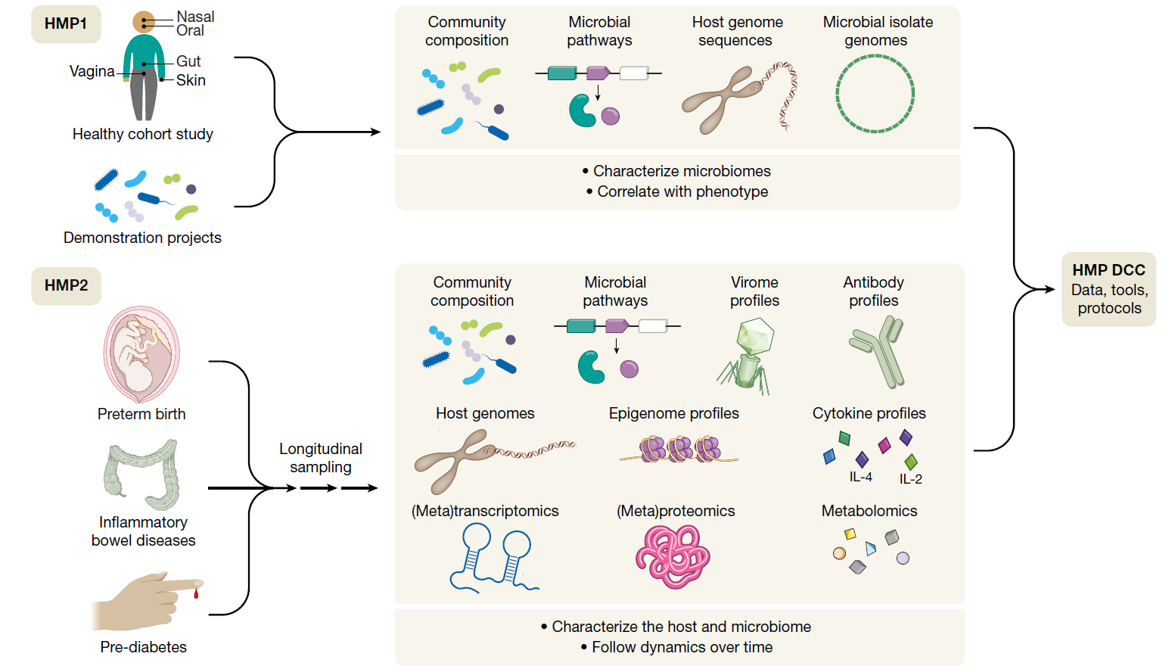
The Human Microbiome Project (Phases I and II)
Lots of data. Most of it still correlative

Slide 14

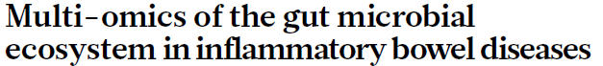
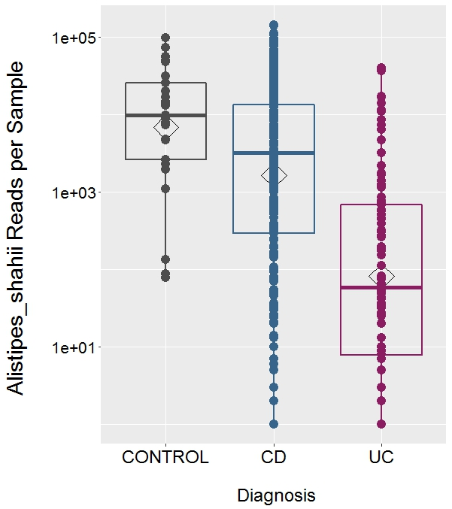
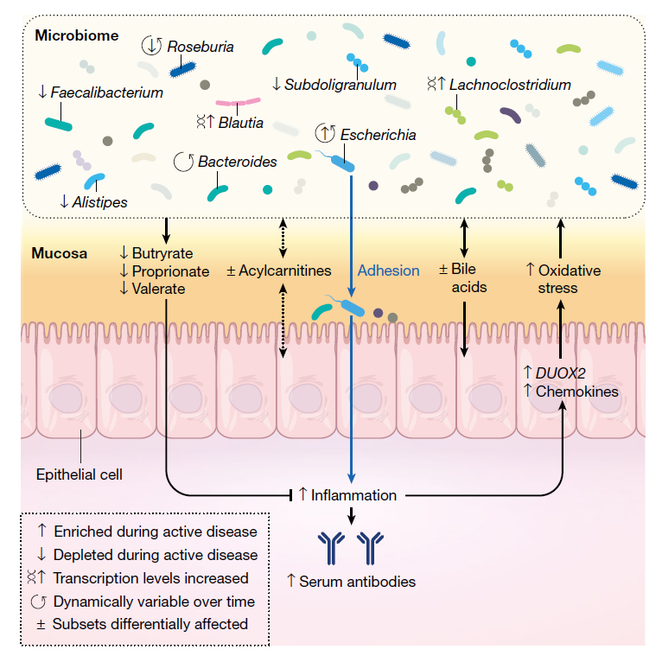
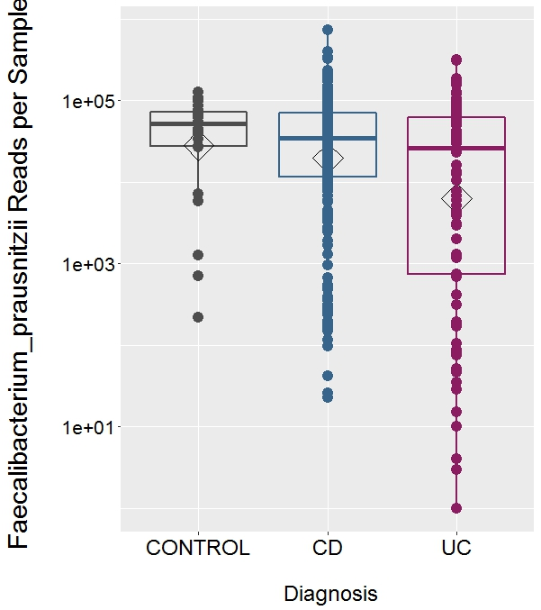
Lloyd-Price, J., et. al. (2019). "Multi-omics of the gut microbial ecosystem in inflammatory bowel diseases." Nature 569(7758): 655-662.

Slide 15
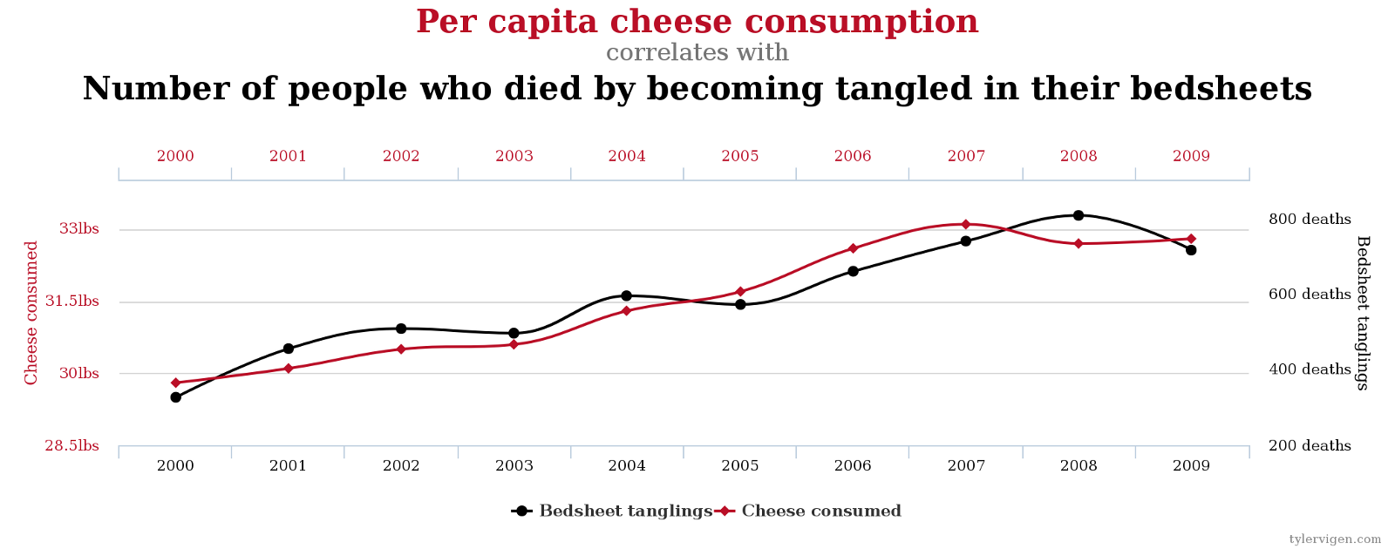
“Association does not prove causation”
with very highly dimensional data (e.g. 16,600 species to choose from) we can probably find associations between microbiome and disease
probably accounts, at least in part, for problems with reproducibility when other patient populations studied

Slide 16
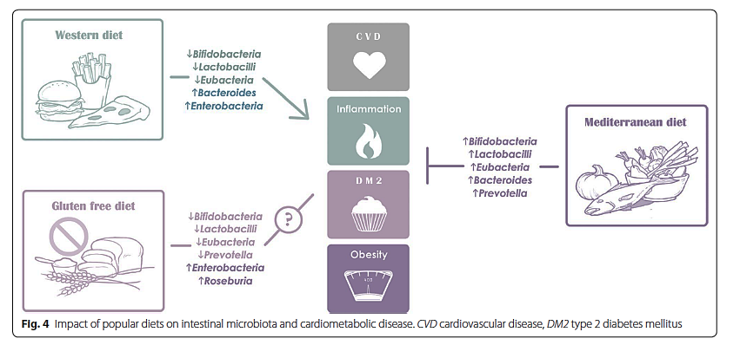
Diet influences the intestinal microbiota and may impact disease susceptibility
Singh RK, Chang HW, Yan D, Lee KM, Ucmak D, Wong K, Abrouk M, Farahnik B, Nakamura M, Zhu TH, et al.: Influence of diet on the gut microbiome and implications for human health. J Transl Med 2017, 15:73.

Slide 17
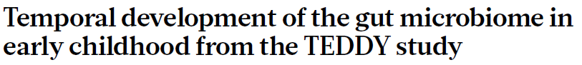
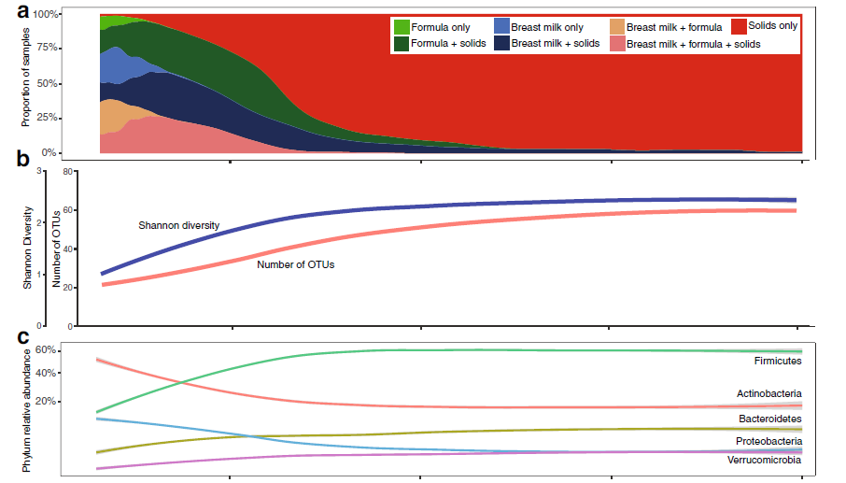
The infant microbiome is low in diversity and variable early in life
Microbiome composition tends to stabilize by 3 years of age
Diet appears to be a major driver of microbiome maturation
Stewart, C. J., et.al. "Temporal Development of the Gut Microbiome in Early Childhood from the Teddy Study." Nature 562, no. 7728 (Oct 2018): 583-88.

Slide 18
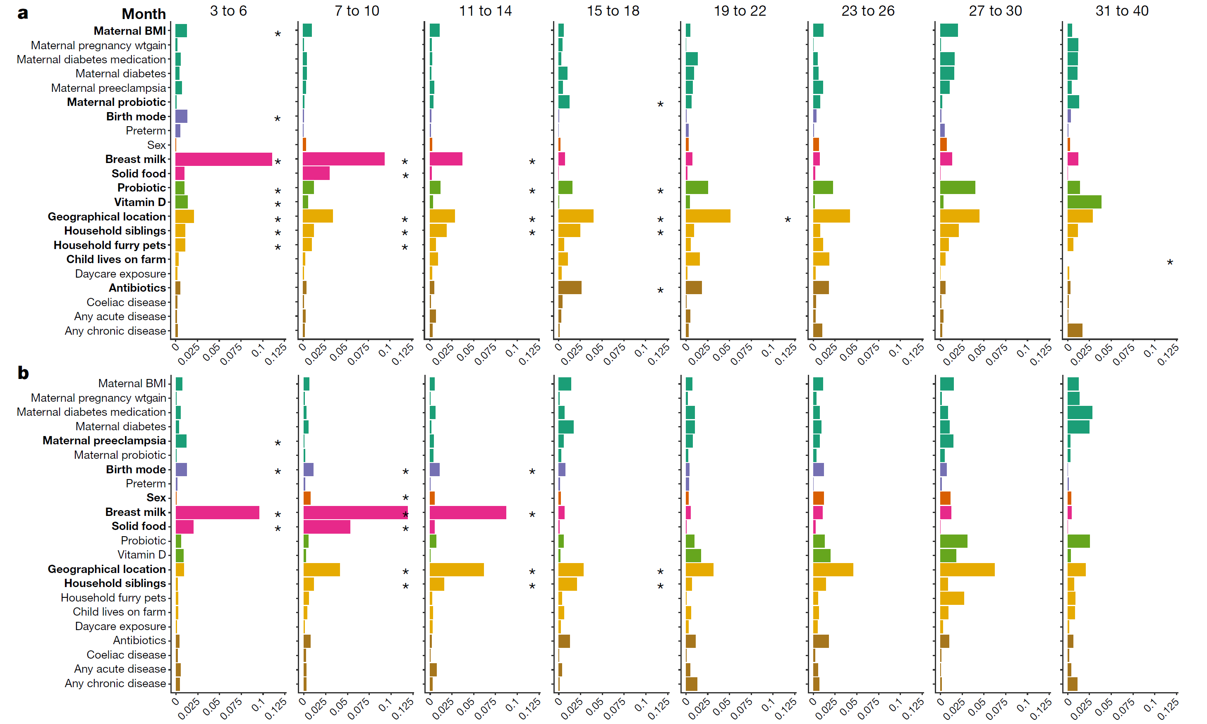
Genus Abundance
16S
Species Abundance
Shotgun Sequencing
Stewart, C. J., et.al. "Temporal Development of the Gut Microbiome in Early Childhood from the Teddy Study." Nature 562, no. 7728 (Oct 2018): 583-88.

Slide 19

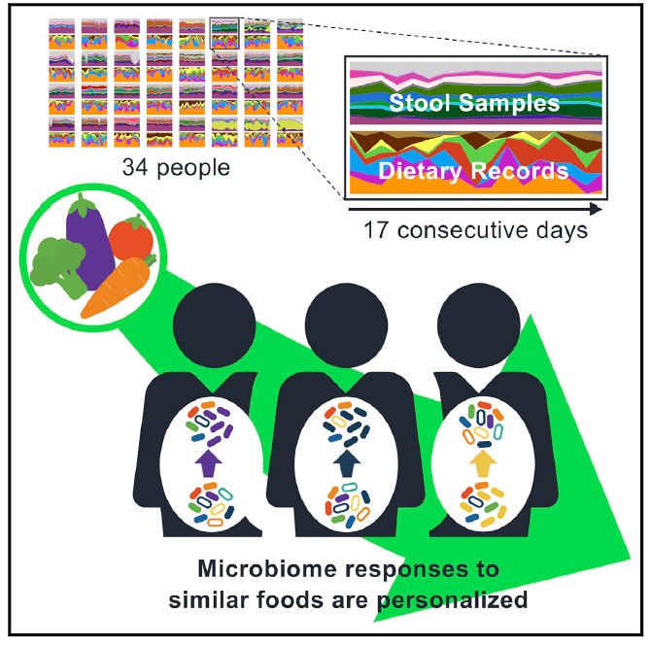
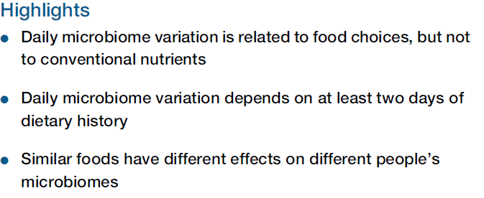

Slide 20
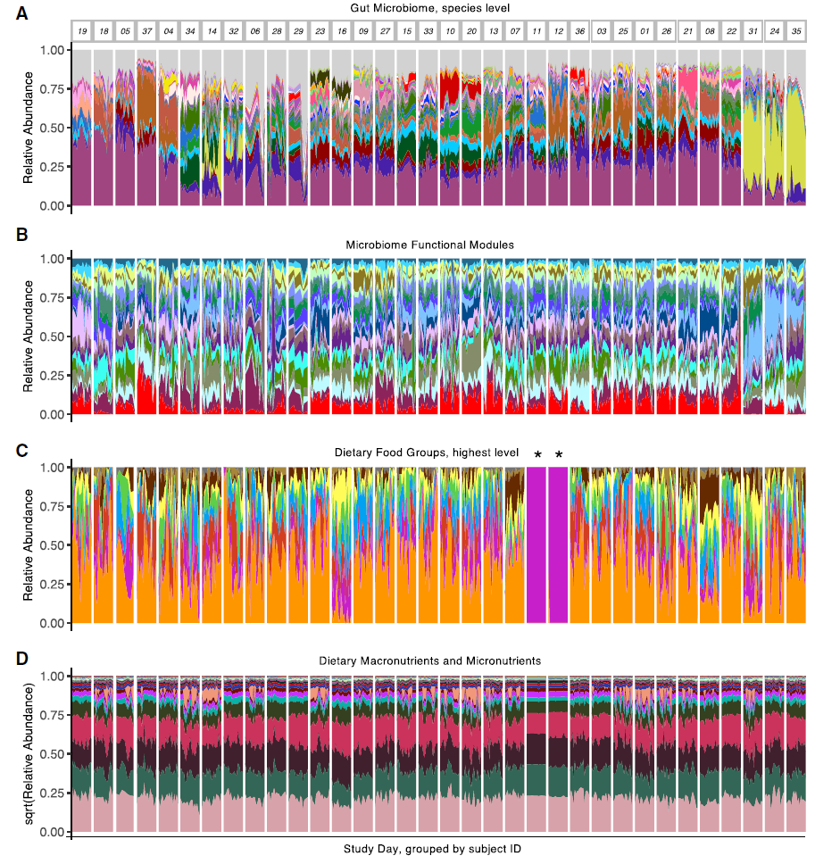
The relationship between diet and microbiome or functional capacity is not straightforward
Diet impacts an individual’s microbiome
However, the same diet may affect different people’s microbiome’s differently
Even people with markedly different diet may have microbiome fairly similar to other individuals

Slide 21
Microbiome Analysis

Slide 22
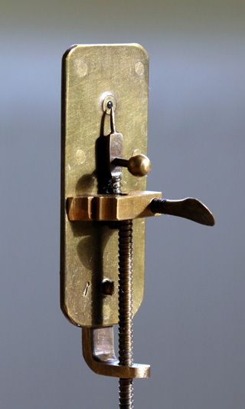
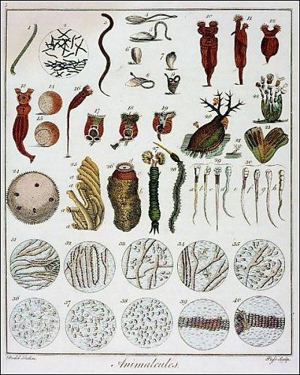

Anthonie van Leeuwenhoek’s oral microbiota (1673)

Slide 23
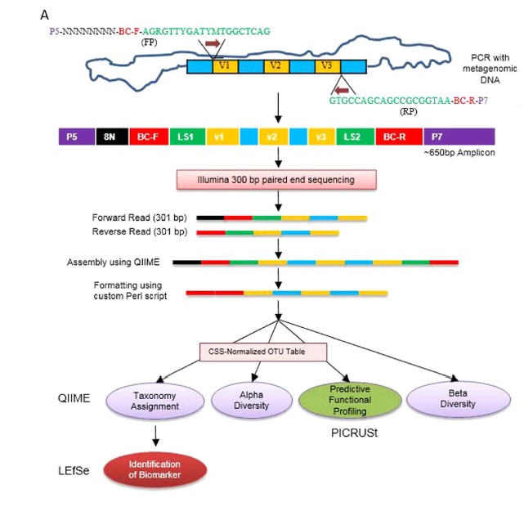
16S rRNA Sequencing of Bacterial Community
segments of 16S ribosomal subunit gene are highly conserved across all bacteria
interspersed regions are highly variable
amplify, sequence and compare variable regions
cannot detect fungi, parasites, viruses
https://www.gatc-biotech.com/en/expertise/targeted-sequencing/16s-rrna-analysis.html

Slide 24

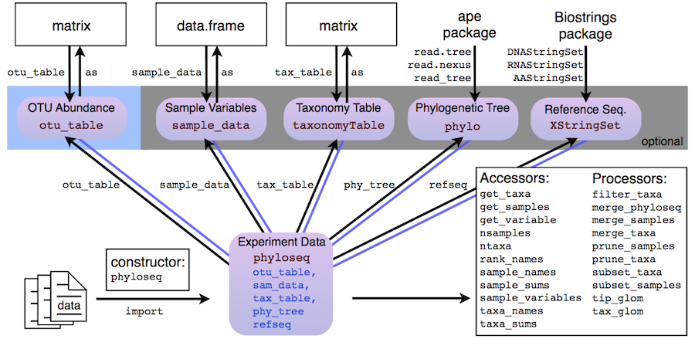

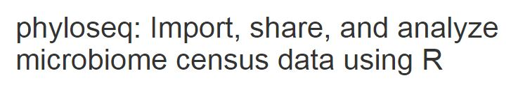
Common tools for 16S rRNA Sequence Analysis
Machine learning
“OTU Table”
OTU = Operational taxonomic unit

Slide 25
#OTU ID | 005.Exp1 | 006.Exp1 | 025.Exp1 | 073.Exp1 | 076.Exp1 | 080.Exp1
k__Bacteria;p__;c__;o__;f__;g__ | 0 | 0 | 0 | 0 | 0 | 0
k__Bacteria;p__Actinobacteria;c__Acidimicrobiia;o__Acidimicrobiales;f__;g__ | 0 | 0 | 0 | 0 | 0 | 0
k__Bacteria;p__Actinobacteria;c__Acidimicrobiia;o__Acidimicrobiales;f__C111;g__ | 0 | 0 | 0 | 0 | 0 | 0
k__Bacteria;p__Actinobacteria;c__Acidimicrobiia;o__Acidimicrobiales;f__Iamiaceae;g__Iamia | 0 | 0 | 0 | 0 | 0 | 0
k__Bacteria;p__Actinobacteria;c__Actinobacteria;o__Actinomycetales;f__;g__ | 0 | 0 | 0 | 0 | 0 | 0
k__Bacteria;p__Actinobacteria;c__Actinobacteria;o__Actinomycetales;f__Actinomycetaceae;g__Actinomyces | 0 | 0 | 0 | 0 | 0 | 0
k__Bacteria;p__Actinobacteria;c__Actinobacteria;o__Actinomycetales;f__Actinomycetaceae;g__Mobiluncus | 0 | 0 | 0 | 0 | 0 | 0
k__Bacteria;p__Actinobacteria;c__Actinobacteria;o__Actinomycetales;f__Brevibacteriaceae;g__Brevibacterium | 0 | 0 | 0 | 0 | 0 | 0
k__Bacteria;p__Actinobacteria;c__Actinobacteria;o__Actinomycetales;f__Corynebacteriaceae;g__Corynebacterium | 0 | 0 | 0 | 0 | 0 | 0
k__Bacteria;p__Actinobacteria;c__Actinobacteria;o__Actinomycetales;f__Dietziaceae;g__Dietzia | 0 | 0 | 0 | 0 | 0 | 0
k__Bacteria;p__Actinobacteria;c__Actinobacteria;o__Actinomycetales;f__Intrasporangiaceae;g__ | 0 | 0 | 0 | 0 | 0 | 0
k__Bacteria;p__Actinobacteria;c__Actinobacteria;o__Actinomycetales;f__Microbacteriaceae;Other | 0 | 0 | 0 | 0 | 0 | 0
k__Bacteria;p__Actinobacteria;c__Actinobacteria;o__Actinomycetales;f__Microbacteriaceae;g__Cryocola | 0 | 0 | 0 | 0 | 0 | 0
k__Bacteria;p__Actinobacteria;c__Actinobacteria;o__Actinomycetales;f__Micrococcaceae;g__Arthrobacter | 0 | 0 | 0 | 0 | 0 | 0
k__Bacteria;p__Actinobacteria;c__Actinobacteria;o__Actinomycetales;f__Micrococcaceae;g__Kocuria | 0 | 0 | 0 | 0 | 0 | 0
k__Bacteria;p__Actinobacteria;c__Actinobacteria;o__Actinomycetales;f__Micrococcaceae;g__Micrococcus | 0 | 0 | 0 | 0 | 0 | 0
k__Bacteria;p__Actinobacteria;c__Actinobacteria;o__Actinomycetales;f__Micrococcaceae;g__Rothia | 0 | 0 | 0 | 0 | 0 | 0
k__Bacteria;p__Actinobacteria;c__Actinobacteria;o__Actinomycetales;f__Nocardiaceae;g__Rhodococcus | 0 | 0 | 0 | 0 | 0 | 0
k__Bacteria;p__Actinobacteria;c__Actinobacteria;o__Actinomycetales;f__Streptomycetaceae;Other | 0 | 0 | 0 | 0 | 0 | 0
k__Bacteria;p__Actinobacteria;c__Actinobacteria;o__Actinomycetales;f__Streptomycetaceae;g__Streptacidiphilus | 0 | 0 | 0 | 0 | 0 | 0
k__Bacteria;p__Actinobacteria;c__Actinobacteria;o__Bifidobacteriales;f__Bifidobacteriaceae;g__Bifidobacterium | 0 | 0 | 0.002393 | 0 | 0 | 0
k__Bacteria;p__Actinobacteria;c__Coriobacteriia;o__Coriobacteriales;f__Coriobacteriaceae;g__ | 4.70E-05 | 8.98E-05 | 0 | 0 | 0 | 0
k__Bacteria;p__Actinobacteria;c__Coriobacteriia;o__Coriobacteriales;f__Coriobacteriaceae;g__Adlercreutzia | 2.35E-05 | 2.24E-05 | 1.76E-05 | 4.52E-05 | 4.80E-05 | 3.21E-05
k__Bacteria;p__Actinobacteria;c__Thermoleophilia;o__Gaiellales;f__Gaiellaceae;g__ | 0 | 0 | 0 | 0 | 0 | 0
k__Bacteria;p__Bacteroidetes;c__Bacteroidia;o__Bacteroidales;Other;Other | 0.000858238 | 0.000942655 | 0 | 0 | 0 | 0.000112
k__Bacteria;p__Bacteroidetes;c__Bacteroidia;o__Bacteroidales;f__;g__ | 0.001634179 | 0.002042419 | 0 | 0 | 0 | 0
k__Bacteria;p__Bacteroidetes;c__Bacteroidia;o__Bacteroidales;f__Bacteroidaceae;g__Bacteroides | 0.351677679 | 0.368510829 | 0.447393 | 0 | 9.60E-06 | 0.09745
k__Bacteria;p__Bacteroidetes;c__Bacteroidia;o__Bacteroidales;f__Porphyromonadaceae;g__Parabacteroides | 0.116955489 | 0.123353159 | 0.286994 | 0 | 1.92E-05 | 4.28E-05
k__Bacteria;p__Bacteroidetes;c__Bacteroidia;o__Bacteroidales;f__Porphyromonadaceae;g__Porphyromonas | 0 | 0 | 0 | 0 | 0 | 0
k__Bacteria;p__Bacteroidetes;c__Bacteroidia;o__Bacteroidales;f__Prevotellaceae;Other | 0.002986198 | 0.002670856 | 0 | 0 | 0 | 0
k__Bacteria;p__Bacteroidetes;c__Bacteroidia;o__Bacteroidales;f__Prevotellaceae;g__ | 0.000634861 | 0.000965099 | 0 | 0 | 0 | 0
k__Bacteria;p__Bacteroidetes;c__Bacteroidia;o__Bacteroidales;f__Prevotellaceae;g__Prevotella | 0.019022314 | 0.020581304 | 0 | 0 | 0 | 0
k__Bacteria;p__Bacteroidetes;c__Bacteroidia;o__Bacteroidales;f__Rikenellaceae;g__ | 0.006148746 | 0.007092358 | 0 | 0 | 0 | 0
k__Bacteria;p__Bacteroidetes;c__Bacteroidia;o__Bacteroidales;f__S24-7;g__ | 0.231618425 | 0.222646168 | 0 | 0.762636 | 0.504984 | 0.410492
k__Bacteria;p__Bacteroidetes;c__Bacteroidia;o__Bacteroidales;f__[Barnesiellaceae];g__ | 0 | 0 | 0 | 0 | 0 | 1.07E-05
k__Bacteria;p__Bacteroidetes;c__Bacteroidia;o__Bacteroidales;f__[Paraprevotellaceae];g__[Prevotella] | 0.023995391 | 0.02298283 | 0 | 0 | 0 | 0
k__Bacteria;p__Bacteroidetes;c__Flavobacteriia;o__Flavobacteriales;f__Flavobacteriaceae;g__Flavobacterium | 0 | 0 | 0 | 0 | 0 | 0
k__Bacteria;p__Bacteroidetes;c__Flavobacteriia;o__Flavobacteriales;f__[Weeksellaceae];g__Cloacibacterium | 0 | 0 | 0 | 0 | 0 | 0
k__Bacteria;p__Bacteroidetes;c__Sphingobacteriia;o__Sphingobacteriales;f__Sphingobacteriaceae;g__Pedobacter | 0 | 0 | 0 | 0 | 0 | 0
k__Bacteria;p__Bacteroidetes;c__Sphingobacteriia;o__Sphingobacteriales;f__Sphingobacteriaceae;g__Sphingobacterium | 0 | 0 | 0 | 0 | 0 | 0
k__Bacteria;p__Bacteroidetes;c__[Saprospirae];o__[Saprospirales];f__Chitinophagaceae;g__ | 0 | 0 | 0 | 0 | 0 | 0
k__Bacteria;p__Cyanobacteria;c__4C0d-2;o__YS2;f__;g__ | 5.88E-05 | 0 | 0 | 0 | 0 | 0
k__Bacteria;p__Cyanobacteria;c__Chloroplast;o__Streptophyta;f__;g__ | 0 | 0 | 1.76E-05 | 6.45E-06 | 0 | 1.61E-05
k__Bacteria;p__Firmicutes;Other;Other;Other;Other | 0.00010581 | 8.98E-05 | 1.76E-05 | 2.58E-05 | 0 | 1.07E-05
OTU = Operational taxonomic unit
cluster of organisms based on similarity of 16S rRNA gene
97% similarity generally cutoff
usually ~ genus level
For some organisms can get to species level
For some organisms cannot get better resolution than phylum or class
OTU Table
relative abundance of organisms at each taxonomic level

Slide 26
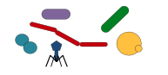


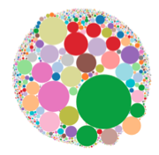
Shotgun metagenomic sequencing
Patient Sample
1. Extract DNA
UltraClean Microbial DNA extraction
Illumina NextSeq500
~20,000,000 x 150 bp reads per sample
2. Randomly fragment then sequence all DNA
3. Align to microbial genome database
Kraken and Braken
Database > 44,000 organisms, including human genome
4. Count number of reads mapped per organism
Additional analysis performed in R.

Slide 27
Species Count Table
Count of number of reads per sample aligning to individual species

Slide 28
Comparison of 16S and Shotgun Metagenomic Analysis
 | 16S RNA Sequencing | Shotgun Metagenomic Sequencing
Sequencing Cost | ~ $25-35 per sample | ~ $220 per sample*
Analysis time | Hours (per sample) | Hours to days (per sample)
Analytic tools | Mature relatively well-standardized | Immature No standard. New tools constantly developed
Taxonomic specificity | OTU (~Genus) | Species to Strain
Functional analysis | No | Possible
Whole genome assembly and analysis | No | Possible
Gene-based analysis (e.g. metabolic, virulence genes, antibiotic resistance) | No | Yes
Captures viruses, fungi, protists | No | Yes

Slide 29
Microbiome Data Analysis

Slide 30
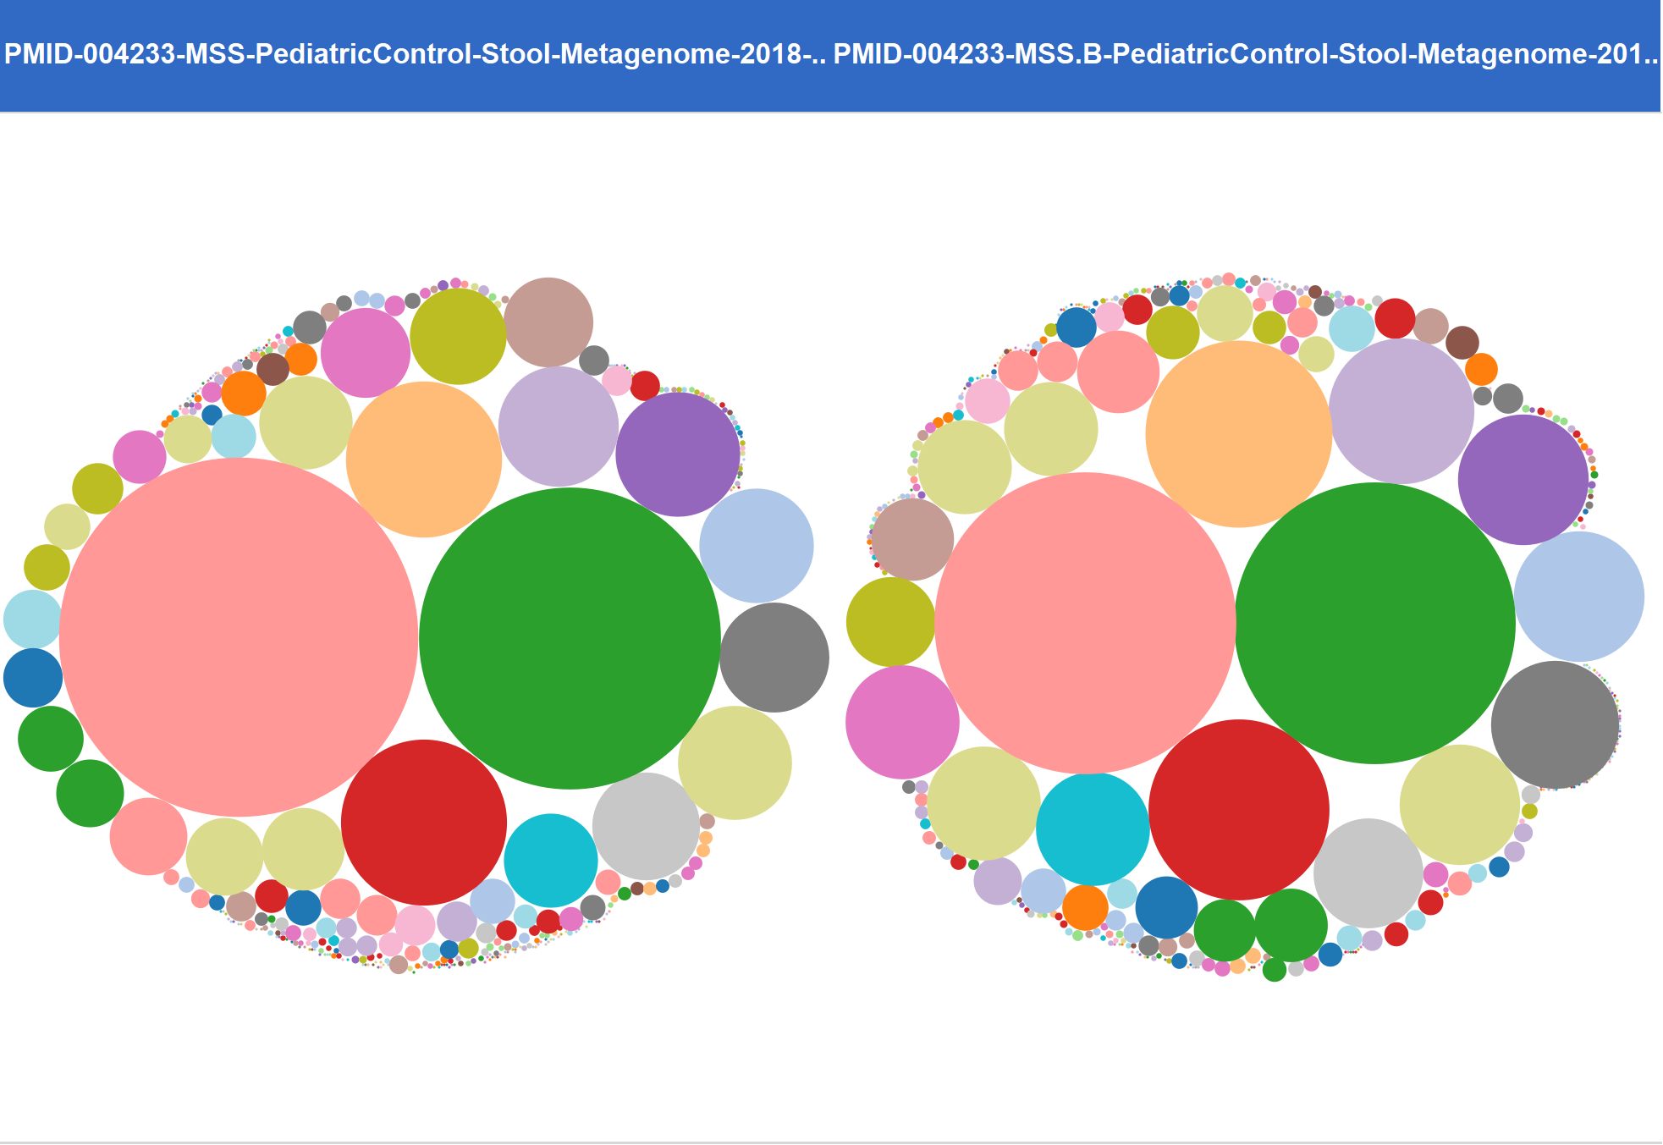
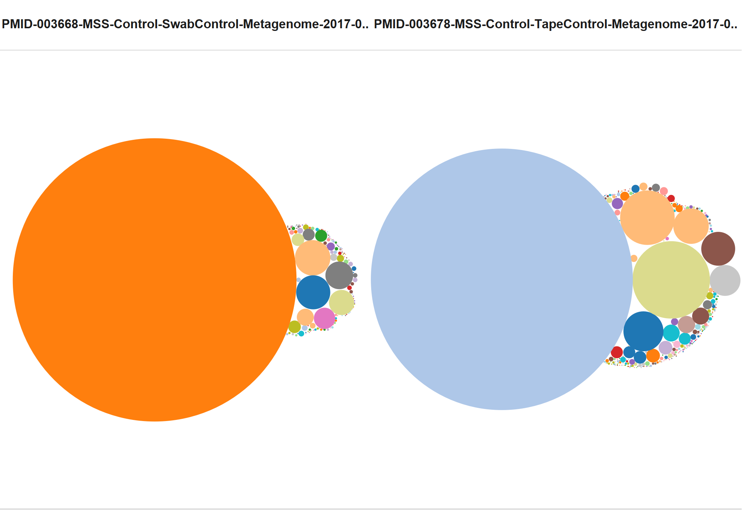
Diversity and Composition are Important Measures of the Microbiome
Good diversity
Stable composition
Low diversity
Variable composition
In general, a ‘healthy’ microbiome is diverse and maintains steady composition

Slide 31
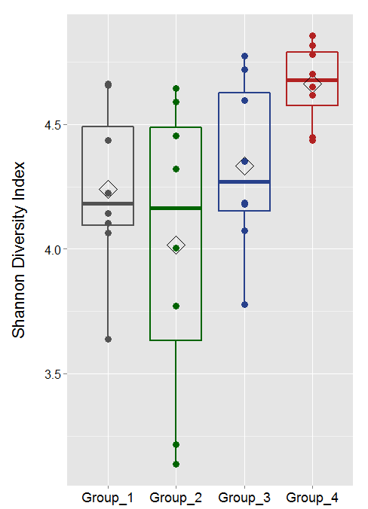
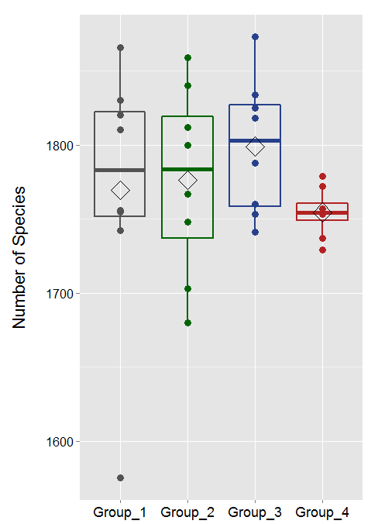
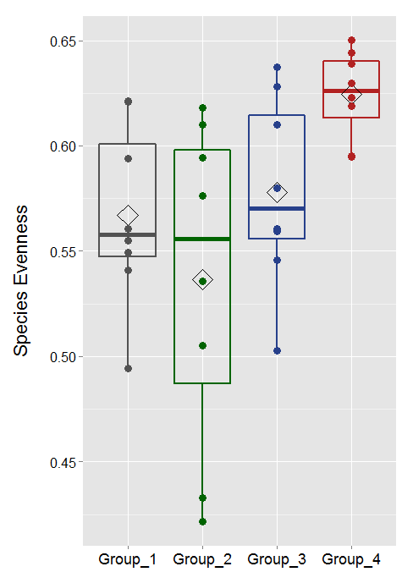
Descriptive Data Metrics
Shannon Diversity
Species per Sample
Species Evenness

Slide 32
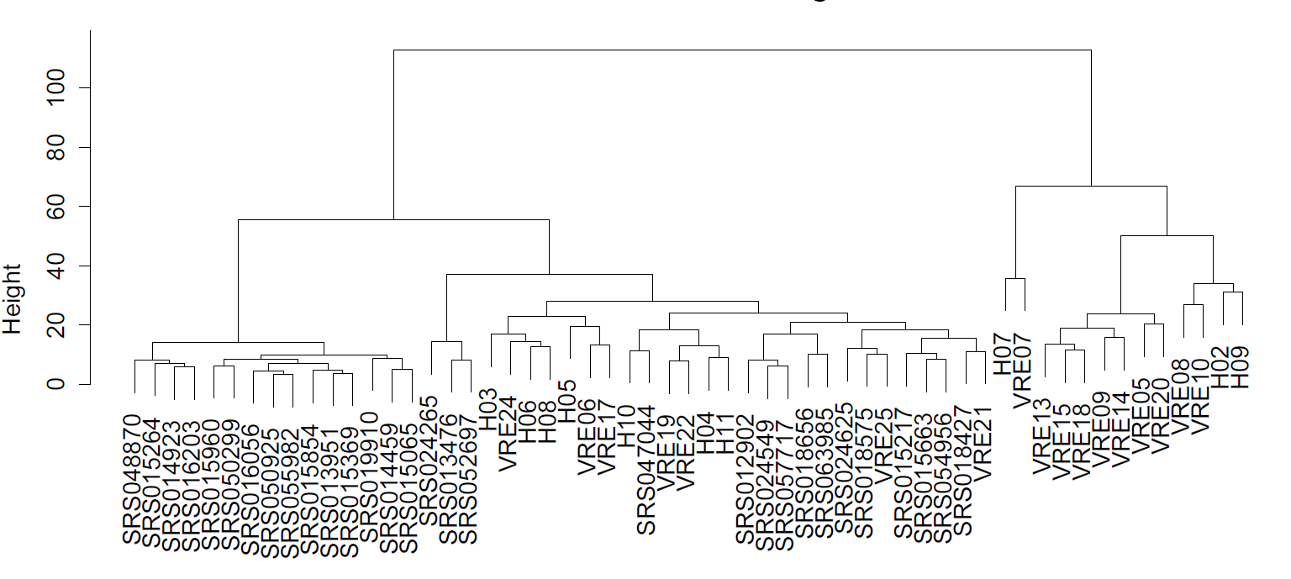
Descriptive Data Visualization
Hierarchical clustering
Much microbiome analysis is based on comparing samples to each other
Composition ~ β-diversity
Based on a ‘distance metric’
Bray-Curtis, Jaccard, Euclidean distances common
A simple clustering algorithm integrates the distance into a one-dimensional distance measure

Slide 33
Distance Measures Commonly Used in Microbiome Studies
Distance Measure | Measured unit | Output
Jaccard | Presence - Absence | Similarity coefficient
Bray-Curtis | Abundance | Dissimilarity measure
Unifrac : Unweighted | Phylogenetic distance Presence - Absence | Qualitiative phylogenetic distance
Unifrac : Weighted | Phylogenetic distance Abundance | Quantitative phylogenetic distance

Slide 34
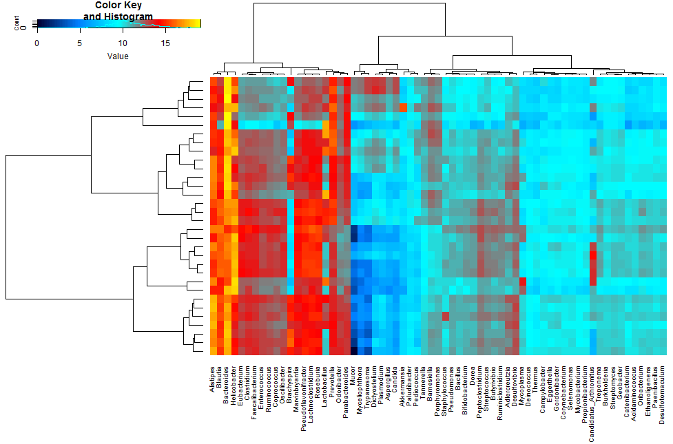
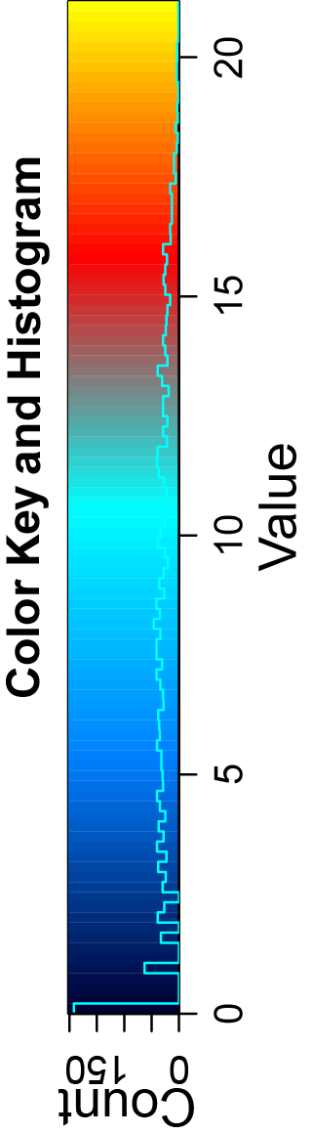
Visualization of Microbiome Composition with Group Comparison
Heat map with hierarchical clustering
Healthy
Disease

Slide 35
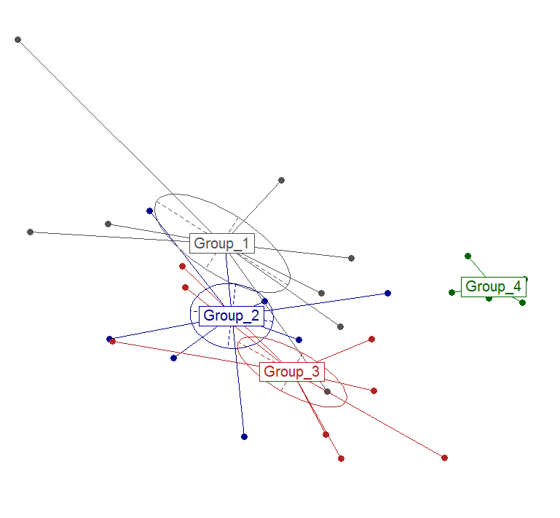
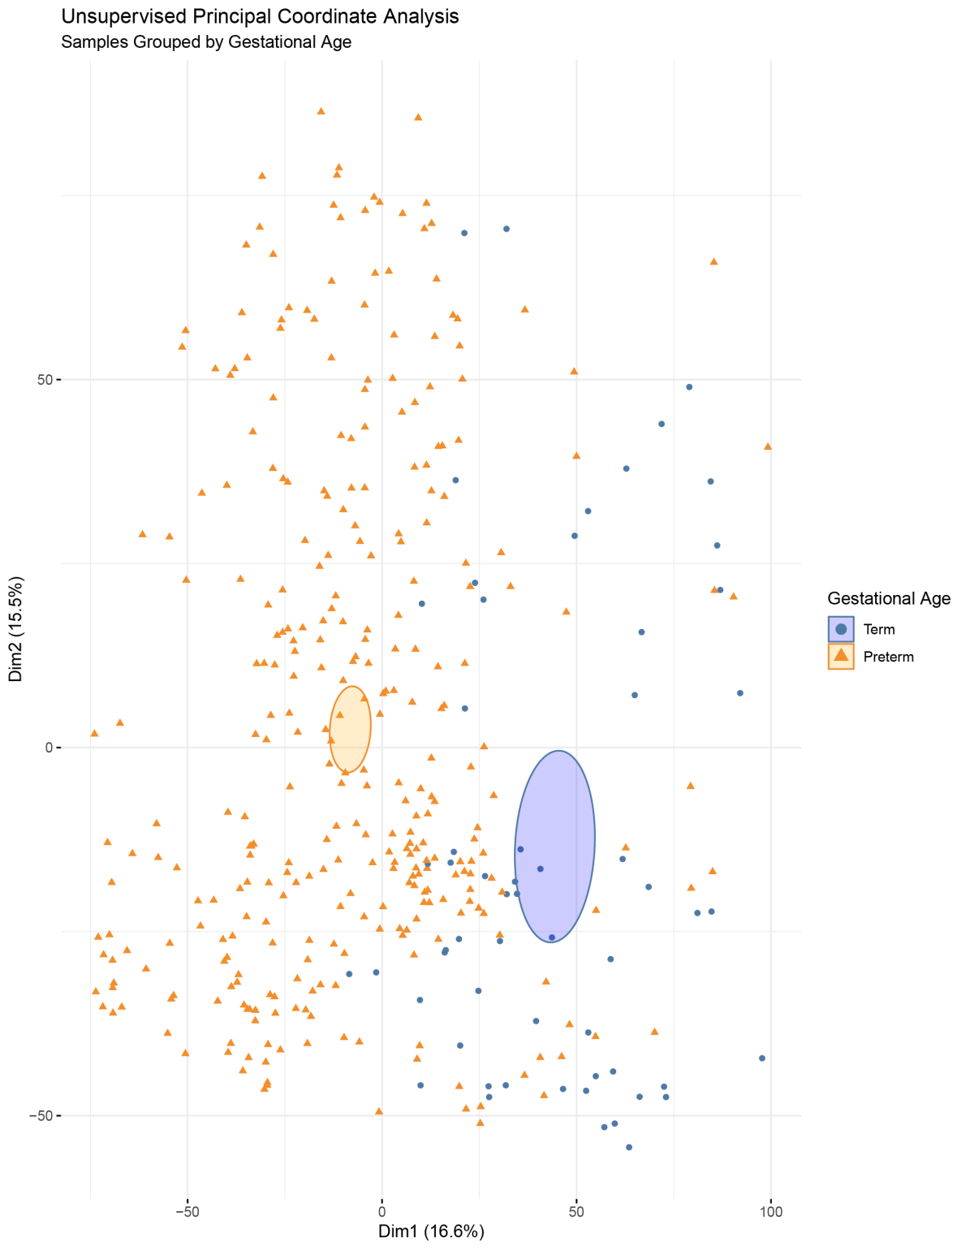
Visualization of Microbiome Composition with Group Comparison
Unsupervised dimension reduction : Principal coordinate analysis (PCA)
PC-2 (18.3%)
Dim2 (15.5%)
PC-1 (32.2%)
2-D or multidimensional representation of composition
Based on ‘latent variables’ comprised of microbiome distance metric
Dim1 (16.6%)

Slide 36
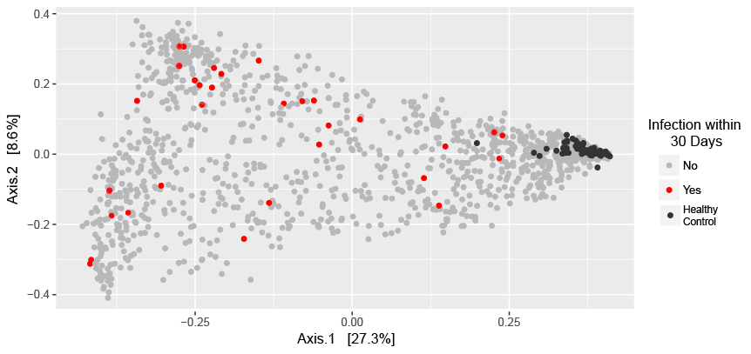
Visualization of Microbiome Composition with Group Comparison
Unsupervised dimension reduction : Multidimensional scaling (MDS)

Slide 37
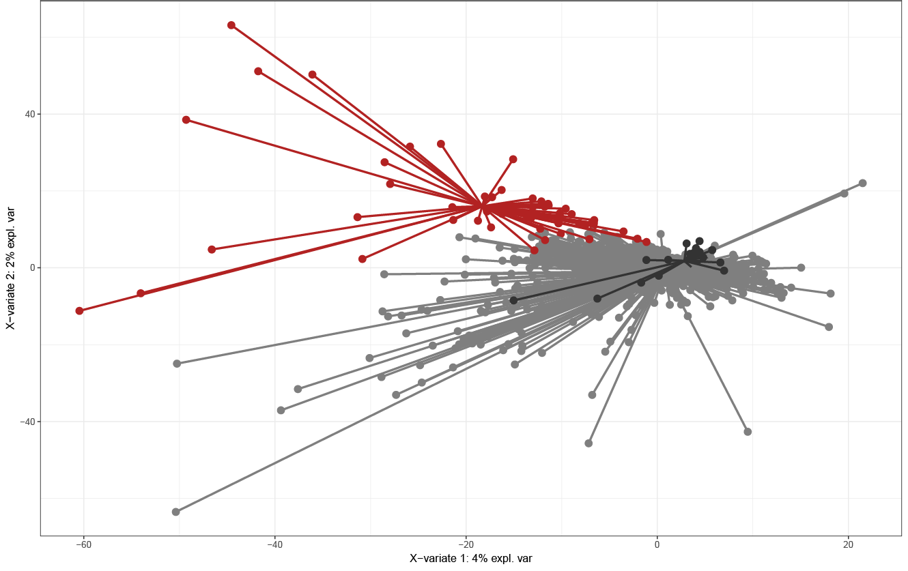
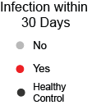
Visualization of Microbiome Composition with Group Comparison
Supervised dimension reduction : Partial least squares discriminant analysis (PLSDA)

Slide 38
Statistical Assessment of Between-group Composition
MRPP
Multi-response permutation procedures
Based on variance between samples within a group and across groups, using a distance metric (e.g. Bray-Curtis)
Multivariate analysis of variance with permutation (PERMANOVA)
Analysis of group similarities (ANOSIM)
Multi-response permutation procedures (MRPP)
Mantel's test (MANTEL)
Dissimilarity index: bray
Class means and counts:
Chance corrected within-group agreement A: 0.07621
Based on observed delta 0.1092 and expected delta 0.1182
Significance of delta: 0.003
Permutation: free
Number of permutations: 999
 | Group_1 | Group_2 | Group_3 | Group_4
delta | 0.1391 | 0.1216 | 0.1147 | 0.03134
n | 8 | 8 | 8 | 8

Slide 39
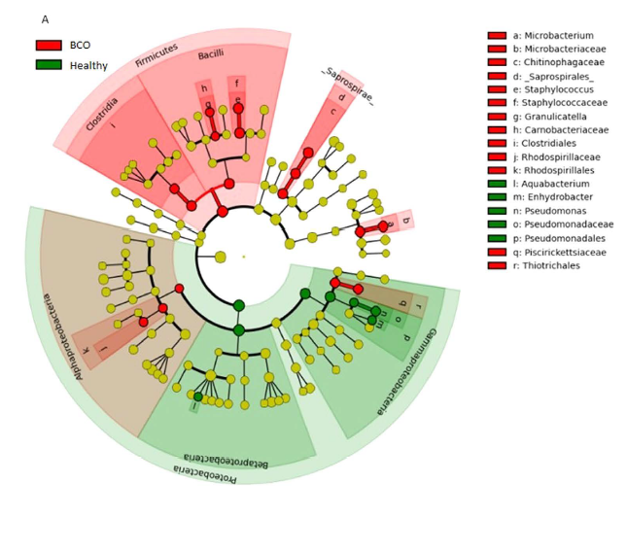
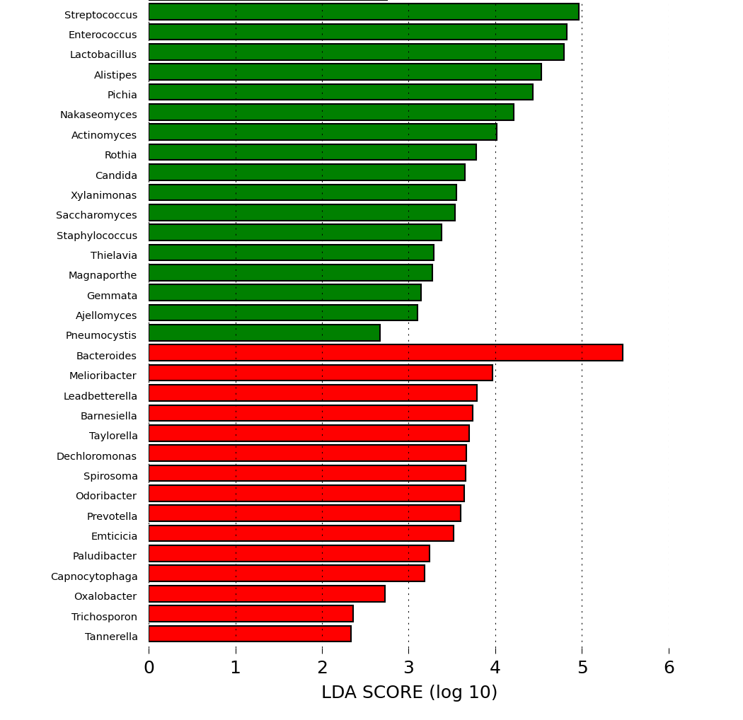
Identification of Individual Taxa that Differ between Groups
LEfSe Linear discriminant analysis Effect Size
Group 4
All Others
historically used with 16S data and seen in many many publications

Slide 40
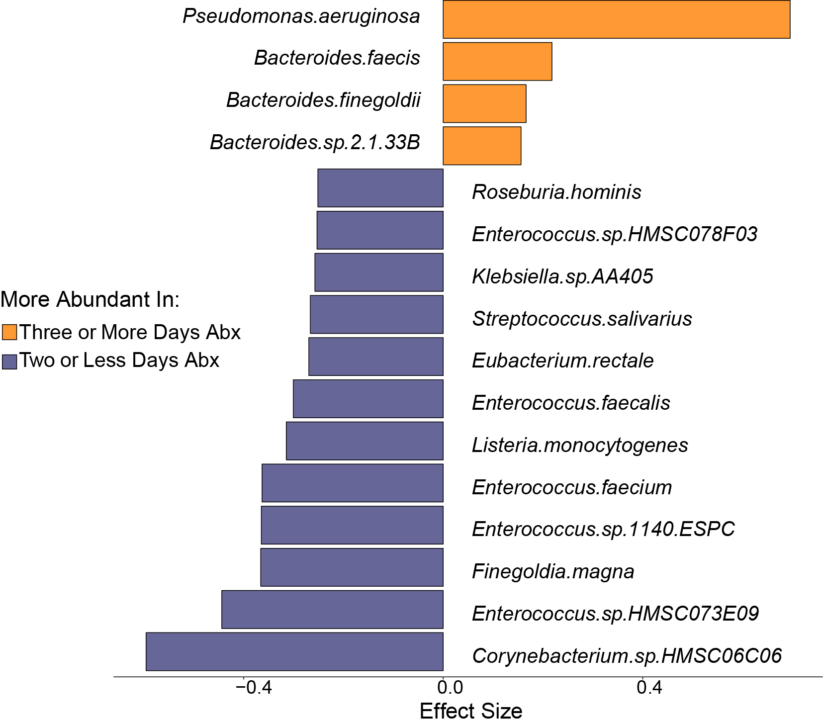
Identification of Individual Taxa that Differ between Groups
We developed Shrinkage Linear Discriminant Analysis (SLDA) with Effect Size*
Correction for multiple testing important (FDR)
Effect size is the group-discriminatory power of a taxa
FDR < 0.1 and effect size > 0.2 could be considered minimal values
*Bernd Klaus - European Molecular Biology Laboratory

Slide 41



Between-group Species Comparisons
Odoribacteria splanchnicus
Prevotella ruminicola
Enterococcus faecalis

Slide 42

Other Approaches to Identify Taxa that Differ Between Groups
Random Forest with Feature Selection
feed species count data to multiple decision trees
random forest algorithm learns which species info are most important in deciding between ‘disease’ or ‘non-disease’
rank species based on their correlation with classification accuracy

Slide 43
Other Approaches to Identify Taxa that Differ Between Groups
identify microbiome components that correlate with disease
can be used to build a disease prediction model
Gao, X., H. Lin and Q. Donga (2017). "A Dirichlet-Multinomial Bayes Classifier for Disease Diagnosis with Microbial Compositions." mSphere: e 2:e00536-00517.

Slide 44
Organisms significantly associated with risk of infection in our patient population
Species | Genus | Family | Phylum | Category | Pathogen | Wilcox p-value
Bacteroides_intestinalis | Bacteroides | Bacteroidaceae | Bacteroidetes | Anaerobe | Non-pathogen | 2.02E-08
Bacteroides_sp_3_1_23 | Bacteroides | Bacteroidaceae | Bacteroidetes | Anaerobe | Non-pathogen | 2.02E-08
Bacteroides_xylanisolvens | Bacteroides | Bacteroidaceae | Bacteroidetes | Anaerobe | Non-pathogen | 2.02E-08
Burkholderiales_bacterium_1_1_47 | Burkholderiales | Burkholderiaceae | Proteobacteria | Aerobe | Non-pathogen | 2.02E-08
butyrate-producing_bacterium_SS3/4 | Unknown | Unknown | Unknown | Other | Non-pathogen | 2.02E-08
Catenibacterium_mitsuokai | Catenibacterium | Erysipelotrichaceae | Firmicutes | Anaerobe | Non-pathogen | 2.02E-08
Coprococcus_sp_ART55/1 | Coprococcus | Lachnospiraceae | Firmicutes | Anaerobe | Non-pathogen | 2.02E-08
Dorea_formicigenerans | Dorea | Lachnospiraceae | Firmicutes | Anaerobe | Non-pathogen | 2.02E-08
Eubacterium_eligens | Eubacterium | Eubacteriaceae | Firmicutes | Anaerobe | Non-pathogen | 2.02E-08
Eubacterium_rectale | Eubacterium | Eubacteriaceae | Firmicutes | Anaerobe | Non-pathogen | 2.02E-08
Roseburia_intestinalis | Roseburia | Lachnospiraceae | Firmicutes | Anaerobe | Non-pathogen | 2.02E-08
Ruminococcus_obeum | Ruminococcus | Ruminococcaceae | Firmicutes | Anaerobe | Non-pathogen | 2.02E-08
Ruminococcus_sp_SR1/5 | Ruminococcus | Ruminococcaceae | Firmicutes | Anaerobe | Non-pathogen | 2.02E-08
Coprococcus_catus | Coprococcus | Lachnospiraceae | Firmicutes | Anaerobe | Non-pathogen | 2.71E-08
Eubacterium_hallii | Eubacterium | Eubacteriaceae | Firmicutes | Anaerobe | Non-pathogen | 2.94E-08
Clostridium_sp_M62/1 | Clostridium | Clostridiaceae | Firmicutes | Anaerobe | Non-pathogen | 4.72E-08
Ruminococcus_torques | Ruminococcus | Ruminococcaceae | Firmicutes | Anaerobe | Non-pathogen | 5.27E-08
Bacteroides_sp_1_1_14 | Bacteroides | Bacteroidaceae | Bacteroidetes | Anaerobe | Non-pathogen | 7.31E-08
Roseburia_inulinivorans | Roseburia | Lachnospiraceae | Firmicutes | Anaerobe | Non-pathogen | 7.31E-08
Bacillus_thuringiensis | Bacillus | Bacillaceae | Firmicutes | Aerobe | Non-pathogen | 7.89E-08
Bacteroides_ovatus | Bacteroides | Bacteroidaceae | Bacteroidetes | Anaerobe | Non-pathogen | 7.89E-08
Roseburia_hominis | Roseburia | Lachnospiraceae | Firmicutes | Anaerobe | Non-pathogen | 7.89E-08
Bacteroides_sp_D20 | Bacteroides | Bacteroidaceae | Bacteroidetes | Anaerobe | Non-pathogen | 8.53E-08
Pseudomonas_aeruginosa | Pseudomonas | Pseudomonadaceae | Proteobacteria | Pseudomonas | Pathogen | 9.91E-08
Ruminococcus_bromii | Ruminococcus | Ruminococcaceae | Firmicutes | Anaerobe | Non-pathogen | 1.33E-07
Eubacterium_siraeum | Eubacterium | Eubacteriaceae | Firmicutes | Anaerobe | Non-pathogen | 1.96E-07
Bacteroides_sp_2_2_4 | Bacteroides | Bacteroidaceae | Bacteroidetes | Anaerobe | Non-pathogen | 1.97E-07
Bacteroides_vulgatus | Bacteroides | Bacteroidaceae | Bacteroidetes | Anaerobe | Non-pathogen | 2.18E-07
butyrate-producing_bacterium_SSC/2 | Unknown | Unknown | Unknown | Other | Non-pathogen | 2.18E-07
Faecalibacterium_prausnitzii | Faecalibacterium | Clostridiaceae | Firmicutes | Anaerobe | Non-pathogen | 2.25E-07
Bacteroides_caccae | Bacteroides | Bacteroidaceae | Bacteroidetes | Anaerobe | Non-pathogen | 2.32E-07
Decrease in protective bacteria appears much more important than increase in pathogens
32 out of 111 shown

Slide 45
Analysis of Features other than Taxa Abundance
Functional ‘potential’ – which genes are present (DNA abundance)
RNA analysis : “Transcriptomics”
Metabolic composition – “Metabolomics”

Slide 46

Functional Analysis of the Microbiome
Functional Profiling
Transcript abundance
Protein abundance
Metabolite abundance
“Who’s there”
“What are they doing”
Adapted from: van den Elsen LWJ, et. al.: Embracing the gut microbiota: the new frontier for inflammatory and infectious diseases. Clinical & Translational Immunology 2017, 6:e125.

Slide 47
There is tremendous variability in microbial species inhabiting different individuals..
.. but much less variability in the metabolic capacity encoded by the microbiota among individuals

Slide 48

Graphical Representation of ‘predicted’ Metabolic Pathways that Differ between Groups

Slide 49

Some Organisms are More Transcriptionally Active Than Others
Transcriptional Activity May be More Important than Abundance
Transcriptional Activity of Bacteria in IBD
Schirmer, M., et. al. "Dynamics of Metatranscription in the Inflammatory Bowel Disease Gut Microbiome." Nat Microbiol 3, no. 3 (Mar 2018): 337-46.

Slide 50

Transcriptional Activity Can be Determined by Comparing RNA Versus DNA Abundance
Escherichia coli
Candida albicans
Klebsiella pneumoniae
Each colored circle represents a species
RNA:DNA ratio = Transcriptional activity
Some species are highly transcriptionally active
Other species have low transcriptional activity
We investigated how antibiotic exposure affected transcriptional activity

Slide 51

Antibiotic Exposure is Associated with Transcriptional Activity of Several Pathogens
Two or Less Days Antibiotics
Three or More Days Antibiotics

Slide 52

Transcriptional Activity of Antibiotic Resistance Genes Ranges from Very High to Very Low (all samples)
Very high transcriptional activity
CTX-M β-lactamases
TEM β-lactamases
CMY β-lactamases
Very low transcriptional activity
RND efflux transporters

Slide 53

Antibiotic Exposure is Associated with Altered Transcription of Many ARG
Two or Less Days Antibiotics
Three or More Days Antibiotics
CTX-M β-lactamases
TEM and CMY β-lactamases
RND efflux transporters

Slide 54



Multi-Omic Data are Interrelated
Not clear yet if one ‘omic’ data type better than another for understanding disease
Lloyd-Price, Jason, et. al.. "Multi-Omics of the Gut Microbial Ecosystem in Inflammatory Bowel Diseases." Nature 569, no. 7758 (2019): 655-62.

Slide 55

Multi-Omic Data are Interrelated
Not clear yet if one ‘omic’ data type better than another for understanding disease

Slide 57
Therapeutic approaches to manipulate the microbiome
Diet
Prebiotics – nutrient or dietary supplement
Probiotics – living organism(s)
Antibiotics *
Fecal Microbiota Transplant (FMT)
* Antibiotics have received the most attention as a treatment for PSC

Slide 58



FMT restores microbiome composition
90 to 95 % cure rate
better than any other treatment
Mir, S., et al. (2014). Current Pediatr Rep 2: 227-234.

Slide 59

FMT displaces pathogenic bacteria from intestinal microbiota
E. coli
Klebsiella
Bacteroides
Faecalibacterium

Slide 60

FMT displaces pathogenic bacteria from intestinal microbiota
E. coli
Veillonella
Klebsiella

Slide 61



FMT has massive effects on the microbiome
Change in microbial abundance
Principal coordinate analysis
Dimension 2 (16.2%)
Dimension 1 (48.2%)
Diversity

Slide 62






FMT displaces pathogenic bacteria from intestinal microbiota
Klebsiella
Enterobacter
Escherichia
Pathogenic Bacteria
Bacteroides
Parabacteroides
Ruminococcus
Commensal Anaerobes

Slide 63
FMT displaces pathogenic bacteria from intestinal microbiota
change in each patient’s anaerobe and pathogen abundance following FMT

Slide 64





Samples stored in Omnigene-Gut compared to ‘fresh’ frozen samples yield essentially identical results

Slide 65

Our lab has collaborated with several others to sequence > 2000 metagenomes

